Slide 1

Best Practices for using Microsoft PowerPoint
Kathryn Muehlberger,
Client Communications Specialist

Slide 2
Getting Started
The ‘Design’ tab can provide useful tools to start
Use Widescreen or Standard slide size
Choose from a variety of slide designs
Make your first slide grab your audience’s attention

Slide 3
Adding Text
Use 3-4 bullet points per slide – less is more!
Keep font size between 18 and 32
For readability, choose left alignment

Slide 4

Slide Content – Adding Images & Figures
Bar charts, photos, and figures should be on a separate slide, but include a title and/or short caption. See example on next slide.
The ‘Insert’ tab has options for adding icons, images, etc.
Like this one here!

Slide 5
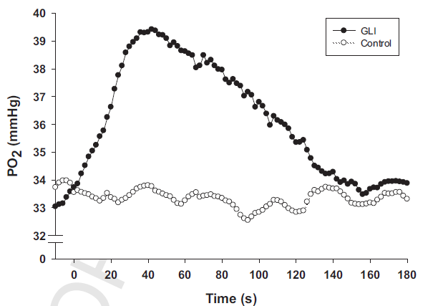
Example: Figure 1
*Use arrows to show the data progress or to further explain the figure
Spinotrapezius PO₂ mv averages post-control and post-GLI infusion
Holdsworth et al. (2015)

Slide 6
Adding Figures (cont.)
When presenting, you can point to your figure or graph or use the arrow shape on the slide.
Decide what is key information to show on the slide; this will help decrease the amount of text.
If the slide has a title summarizing the results, then a figure legend may not be needed.

Slide 7
Adding Multi-Panel Figures
Arrange multi-panel figures horizontally left to right while maintaining a readable size from the audience’s perspective.
If the figure contains detailed data, then choose 1-2 panels per slide and show the remaining panels on the next slide.
Follow same tip when choosing text per slide.
Keep a brief title of figure.

Slide 8
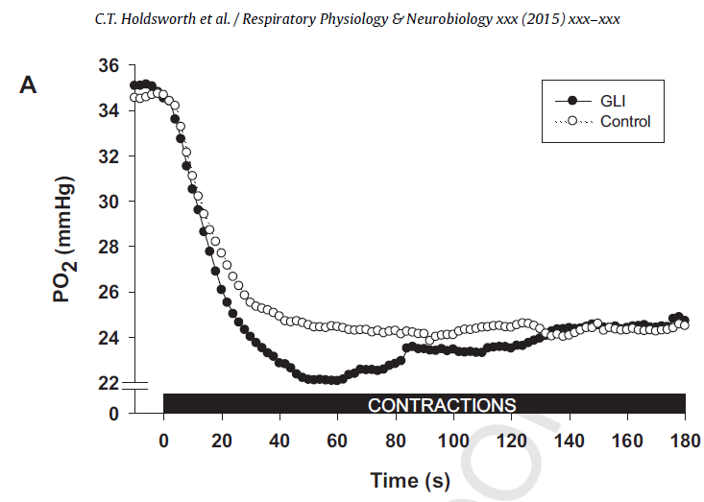
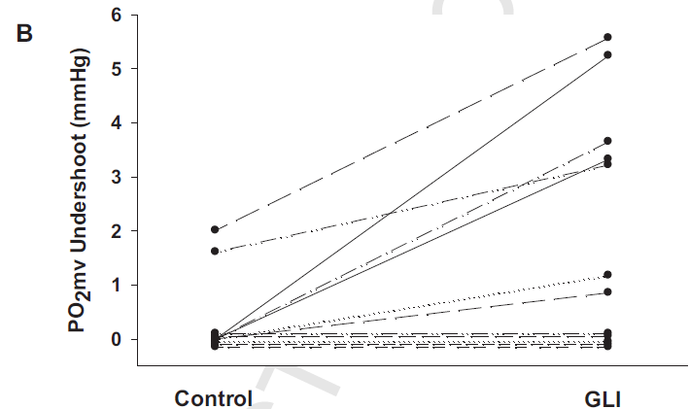
Example: Figure 2
(A) Representative spinotrapezius PO₂ mv profile for control and GLI
(B) Individual ⃤ ₂ PO₂ mv responses to GLI
Holdsworth et al. (2015)

Slide 9
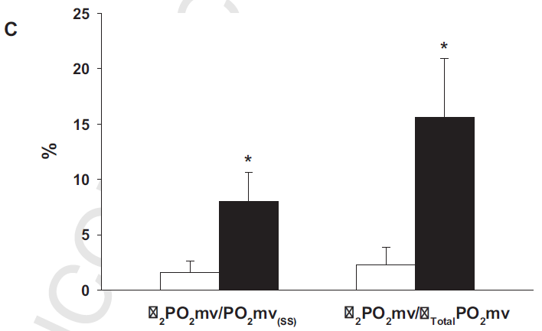
Example: Figure 2 (cont.)
(C) The ⃤ ₂ PO₂ mv as a function of both the steady state and total amplitude *p < 0.05 vs control
Holdsworth et al. (2015)

Slide 10
Visual Effects:
Go to the Animations slide and click Preview to see the effects we created on this slide!
Don’t go overboard with animations, sounds, or slide transitions
Focus on the content rather than using effects to enhance your presentation

